Slide 1
The Borneo Elephant
By:

Slide 2
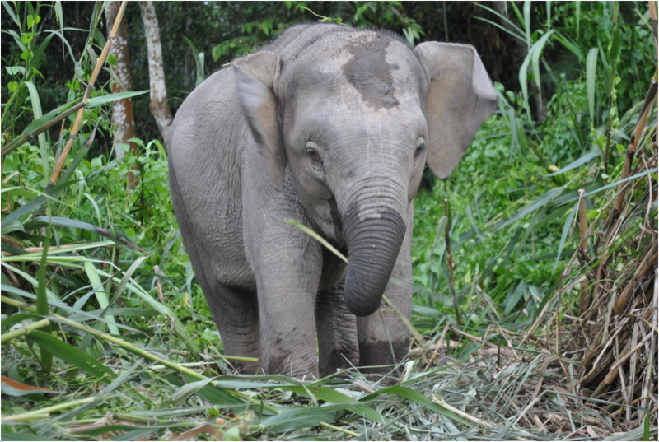
Introduction
Most people don’t know about the Borneo elephant, the most commonly known elephants are the African elephant and the Asian elephant. Because of this, the Borneo elephants population has dropped to 15,000! Which is in the critically endangered department! I am trying to save the Borneo Elephants and this report is on what we can do to save the Borneo Elephant, how can we save the Borneo Elephant, how did they become critically endangered, and some fun features about the Borneo Elephant.
https://animalsadda.com/borneo-pygmy-elephant/

Slide 3
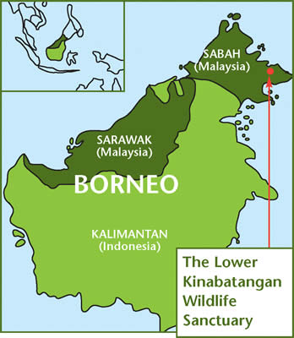
What is the Borneo elephant?
The Borneo elephant is a critically endangered species that live in Borneo. It is also a subspecies of the Asian elephant which is a more popular type of elephant. The Borneo elephant is critically endangered because of habitat loss. The WWF association is trying to bring back the Borneo elephant. The WWF is short for world wildlife fund. They help animals that are endangered too.
Here is a map of were the Borneo elephants live.
https://www.google.com/maps/@10.4936226,104.3527922,4.63z
http://egagah.blogspot.com/2011/12/australian-woman-gored-to-death-by.html

Slide 4
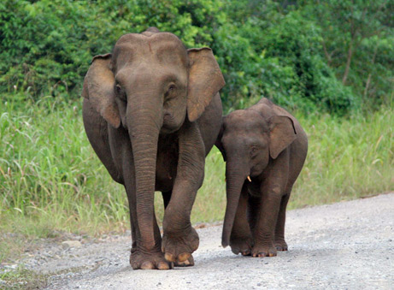
How Can We Save The Borneo Elephant
A way we can save the Borneo elephant is not ruining there habitat. Over the years the numbers in Borneo elephants has gone up, but not enough. We need this species to have a whopping come back! Again, WWF has been trying to save the Borneo elephants for a while.

Slide 5
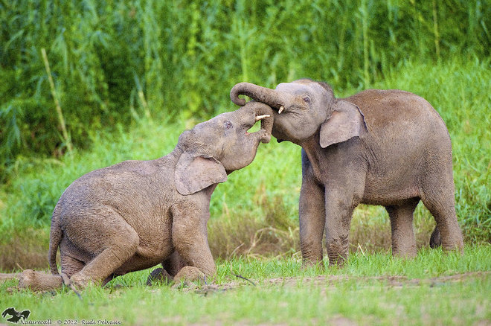
Why is the Borneo elephant critically endangered?
The Borneo elephant is critically endangered because of habitat loss and fragmentation of habitat, witch basically means they used to have a big habitat area, but then it shrunk over time. It is easy to pick on the Borneo elephant species just because they are not aggressive at all! Because of this, there are only 15,000 Borneo elephants left!
http://egagah.blogspot.com/2011/12/australian-woman-gored-to-death-by.html

Slide 6
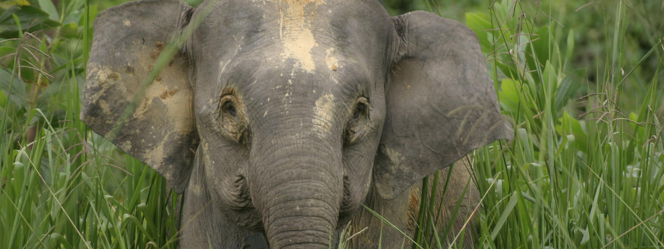
Fun Features
One fun feature of the Borneo elephant it there big feet and long trunk, it is unknown why they have these things. Another fun feature of the Borneo elephant is there birth marks. My thought on this is since there species is confined to the island of Borneo. The same elephants breed together and the same birth mark that once was one elephant, is know all the babies birthmark. Again, this is my thought. I didn’t find any information on this.

Slide 7
Video
Here are some short videos on Borneo elephants.
https://www.youtube.com/watch?v=XNyhF9t-XfA
https://www.youtube.com/watch?v=txc48y5XgPY

Slide 8
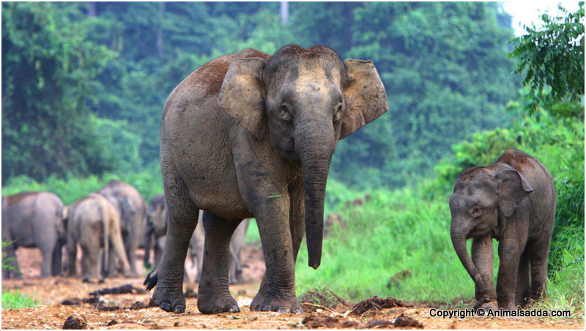
Bibliography
https://animalsadda.com/borneo-pygmy-elephant/
http://egagah.blogspot.com/2011/12/australian-woman-gored-to-death-by.html
https://news.nationalgeographic.com/news/2007/08/photogalleries/pygmy-elephants/photo3.html
https://sugarandspiceinvitations.com/products/elephant-thank-you-card-blue
https://sustainablepulse.com/2013/01/30/rare-borneo-pygmy-elephant-deaths-panic/#.WxgcO0gvzIU

Slide 9
Conclusion
I hope you enjoyed my presentation, you should have learned what the Borneo elephants, how we can save this species, why are Borneo elephants critically endangered, and some fun features.
https://news.nationalgeographic.com/news/2007/08/photogalleries/pygmy-elephants/photo2.html

