Slide 1
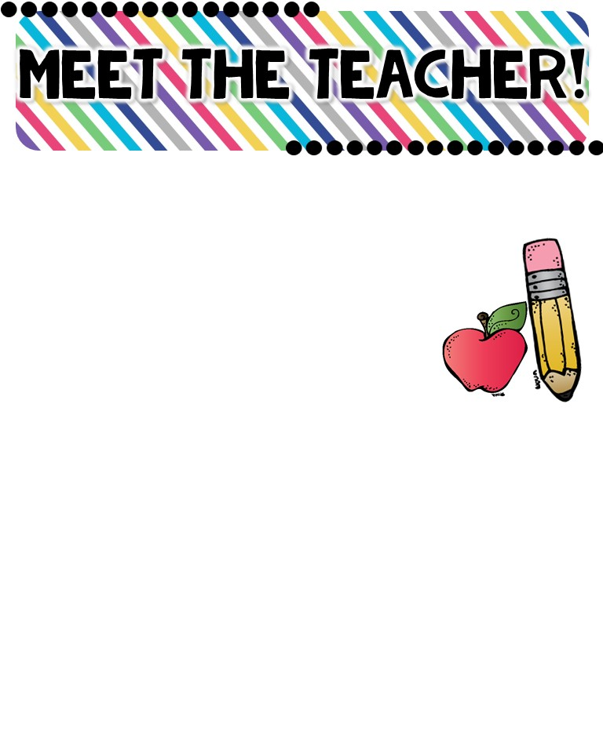
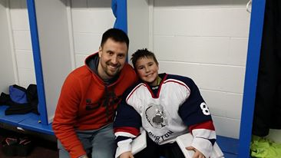
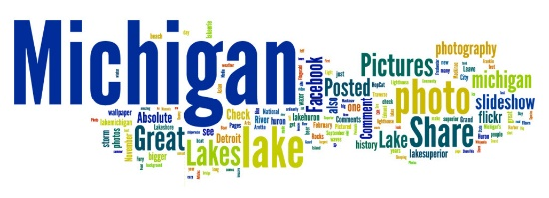
Mr. Cawson
The Basics!
Hi! My name is Mr. Cawson! I live in Owosso, Michigan. In fact, I just moved there as I bought my first house! Prior, I lived in Fenton, Michigan. I really enjoy being with friends and family. I also love spending time up north, playing sports and working on my new home. I will be your new 5th grade teacher for the 2018-2019 school year! This will be my 7th year teaching & I am excited to make this my best year yet!
MY CHILDHOOD!
I grew up in the countryside of Fenton, MI where I attended Fenton Schools. I graduated from Fenton in 2007.
MY FAVORITES!
MY EDUCATION!
Book: “Holes”
Color: Pink
Drink: Milk, Dr. Pepper, and Mountain Dew.
Season: Summer
Sports: Basketball
Fast Food: Pizza
Music: Country/Hip Hop
Hobby: Basketball Tournaments Subject: Science/Social Studies
Store: Home Depot!
Dessert: Rootbeer Float/Brownies
Candy: Milky Way/Twix
Restaurant: Olive Garden!
I graduated from the University of Michigan-Flint with a Bachelor's degree in elementary education and I earned a Master’s degree later on from there in administration. I am still a big Michigan State fan!
CONTACT ME!
Email: Robert.cawson@elps.us
Class Webpage: www.eduresourceneeds.weebly.com
Or www.teachingdesire.weebly.com
School Phone Number: (517) 333-7930

